Slide 1
AMAZON WEB SERVICES
AWS
Aissatou Barry
Widade Harchan
Jaime Chauca

Slide 2


WHAT IS AMAZON?
Amazon is the world's largest online retailer.
Amazon was originally a bookseller, it has expanded to the point to sell its own electronic devices like Kindle Fire tablet, Fire TV
In 2006 Amazon began offering IT Services known as Cloud Computing.

Slide 3

CLOUD COMPUTING
Cloud computing is a method of providing a set of shared computing resources that includes applications, computing, storage, networking, development, and deployment platforms as well as business processes.

Slide 4
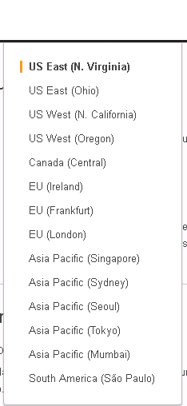
WHAT IS AWS?
AWS is the delivery of compute power, database storage, applications, and other IT resources through a cloud services platform via the internet with pay-as-you-go services.
AWS serves in more than 190 countries and continues expanding their global infrastructure to help their customers.
AWS cloud operates 42 AZs (Availability Zones) within 16 geographic regions around the world.
Region is the physical location, while availability zones consist of one or more distinct data centers, each with useful power, networking and connectivity.

Slide 5
AMAZON WEB SERVICES
AWS offers many cloud-based products which includes:
Computing
Storage
Databases
Analytics
Networking
Mobile
Developer tools
Management tools
IoT and security
Enterprise applications

Slide 6

STORAGE
Cloud storage is a simple and scalable way to store, access, and share data over the Internet
Cloud storage is typically more reliable and secure than traditional storage systems.
The use of cloud storage eliminates the costs of buying and maintaining your own storage infrastructure.

Slide 7
STORAGE SERVICES
Amazon Simple Storage Service (S3)
Amazon Elastic Block Store (EBS)
Amazon Elastic File System (EFS)
Amazon Glacier
AWS Storage Gateway
AWS Snowball
AWS Snowball Edge
AWS Snowmobile

Slide 8

AMAZON S3
Is an object storage with a simple web service such as to store and retrieve any amount of data from anywhere on the web.
It is designed to deliver 99.999999999% durability, and scale past trillions of objects worldwide.
It's simple to move large volumes of data into or out of Amazon S3 with Amazon's cloud data migration options
Features includes : Simple data transfer, Easy to manage, scalable and so forth.

Slide 9

AMAZON ELASTIC BLOCK STORE
Provides block storage volumes for Amazon EC2 instances in the AWS Cloud
Provides protection from component failure, offering high availability and durability.
Features includes : High performance volumes , Availability , Encryption Access Management and Snapshots

Slide 10

AMAZON ELASTIC FILE SYSTEM
Provides simple, scalable file storage for Amazon EC2 instances in the AWS Cloud.3
Storage capacity is elastic as you add and remove files for available storage for your applications
Amazon EFS is designed for a broad spectrum of workloads which includes:
Applications, big data and analytics, media processing workflows, content management, web serving, and home directories.

Slide 11
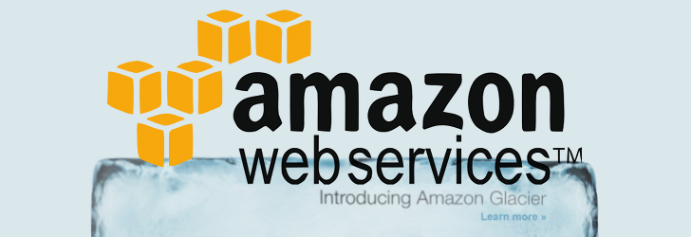
AMAZON GLACIER
Amazon Glacier is a secure and extremely low-cost cloud storage service for data archiving and long-term backup
Customers can reliably store large or small amounts of data for as little as $0.004 per gigabyte per month
Benefits includes : low cost, security, simplicity, flexibility and many more.

Slide 12
AWS STORAGE GATEWAY
is a hybrid storage service that enables your applications to use storage in the AWS Cloud.
use the service for backup and archiving, disaster recovery, cloud bursting, storage tiering, and migration.
Features include: connect as a file server, connect as a local disk, connect as a virtual tape library and transfer data into and out of the AWS Cloud

Slide 13
AWS SNOWBALL
Snowball is a data transport solution that uses secure appliances to transfer large amounts of data into and out of the AWS cloud.
Snowball addresses common challenges with large-scale data transfers like
- High network costs
- Long transfer times
- Security concerns
- Features include: Simple to use, fast, secure, and low cost.

Slide 14
AWS SNOWMOBILE
AWS Snowmobile is a data transfer service used to move extremely large amounts of data to AWS
Snowmobile makes it easy to move video libraries, images, or even a complete data center migration
Features include: Multiple layers of security, GPS tracking, alarm monitoring and 24/7 video surveillance

Slide 15
AWS SNOWBALL EDGE
AWS Snowball Edge is a 100TB data transfer device.
Snowball Edge is used to move large amounts of data into and out of AWS, as a temporary storage .
Benefits of AWS Snowball Edge :
Easy data movement , simple to use , process data locally , stand-alone storage , secure, scalable

Slide 16
Conclusion
Amazon grew from being a bookseller to selling its own AWS cloud computing system.
AWS provides many services as mentioned before for very low cost
Both Students and businesses uses AWS for personal or business.
AWS is simple to use, AWS website provide the resources to learn about the different services and use them.

Slide 17
Bibliography
file:///C:/Users/23179848/Downloads/aws-overview.pdf
https://aws.amazon.com/products/
https://aws.amazon.com/getting-started/tutorials/launch-windows-vm/
https://aws.amazon.com/what-is-aws/
http://whatis.techtarget.com/definition/Amazon

